Slide 1



Communication and In-group Working Skills (cont.)

Slide 2
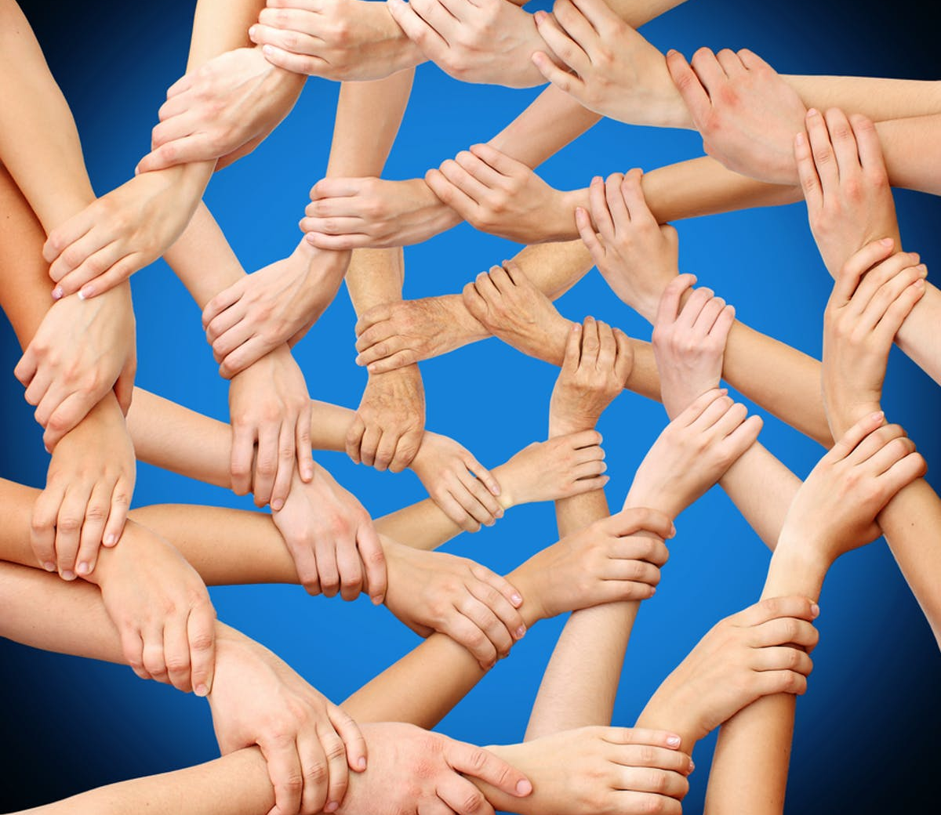
2. Cooperation

Slide 3

The Prisoner’s Dilemma

Slide 4
The Prisoner’s Dilemma
Imagine that you are a participant in a social experiment. As you sit down, you are told that you will be playing a game with another person in a separate room.
The other participant is also part of the experiment but the two of you will never meet. In the experiment, there is the possibility that you will be awarded some money.

Slide 5
The Prisoner’s Dilemma
Both you and your unknown partner are required to make a choice: either choose to “cooperate,” maximizing your combined reward, or “defect”, (not cooperate) and thereby maximize your individual reward.
The choice you make, along with that of the other participant, will result in one of three unique outcomes to this task, illustrated below in the next Figure.

Slide 6
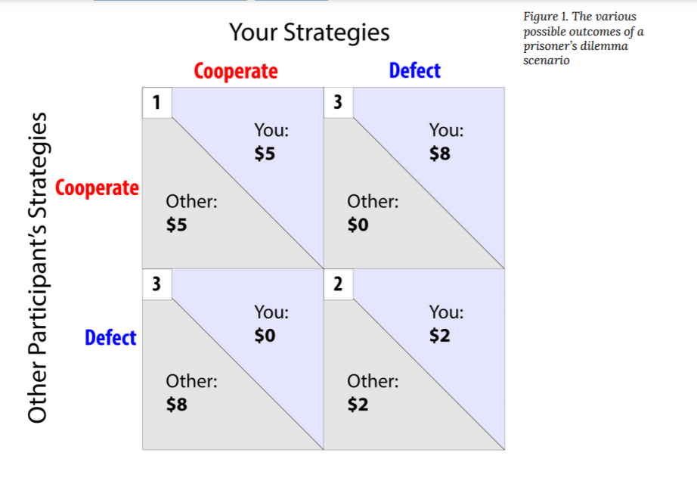
Which strategy would you choose?

Slide 7
Individual Differences in Cooperation
Social Value Orientation (SVO)
01
To want to bring about
positive outcomes for all
Cooperative Orientation
02
To be less concerned about the outcomes of others
Individualistic Orientation
03
To seek to undermine others in order to get ahead
Competitive Orientation

Slide 8
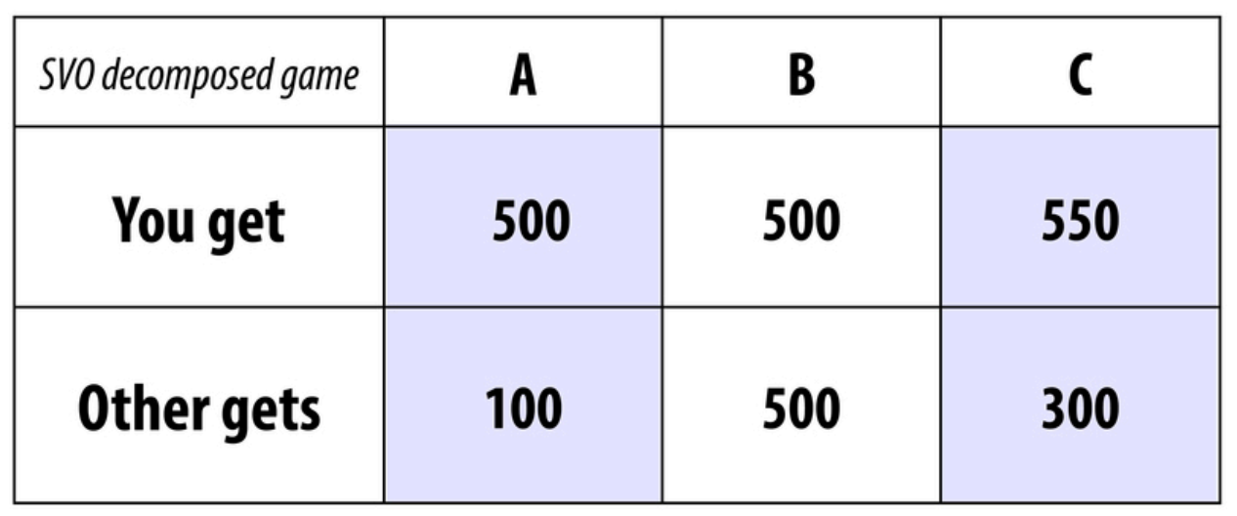
Competitive
orientation
Cooperative
orientation
Individualistic
orientation
Distributions of resources between oneself and an “OTHER”

Slide 9
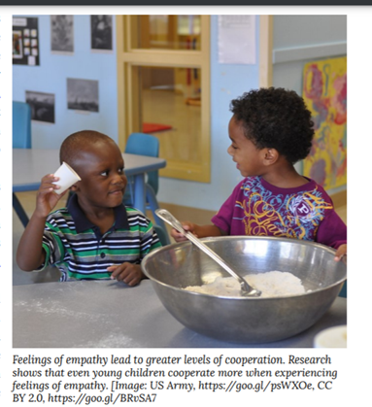
Individual Differences in Cooperation
Empathic Ability
Empathy is the ability to feel and understand another’s emotional experience. When we empathize with someone else, we take on that person’s perspective, imagining the world from his or her point of view and vicariously experiencing his or her emotions
(Davis, 1994; Goetz, Keltner,
& Simon-Thomas, 2010).

Slide 10

Communication
Commitment
Trust
Group Identification
Culture
Situational Influences of Cooperation

Slide 11
Discussion Questions
1. Which groups do you identify with? Consider sports teams, hometowns, and universities. How does your identification with these groups make you feel about other members of these groups? What about members of competing groups?
2. Thinking of all the accomplishments of humanity throughout history which do you believe required the greatest amounts of cooperation? Why?
3. In your experience working on group projects - such as group projects for a class - what have you noticed regarding the themes presented in this module (eg. competition, culture, cooperation, trust)? How could you use the material you have just learned to make group projects more effective?

Slide 12


